Slide 2
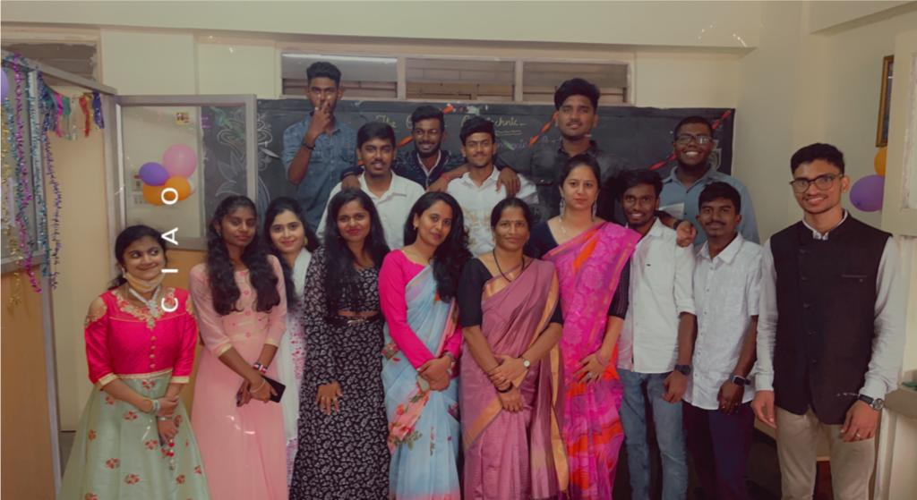
SUCCESFUL ALUMNI REPORT
The Alumni Associations of The Oxford Polytechnic organized ‘’Alumni Meet 2020”. A Program to facilitate, and coordinate Alumni activities at The Oxford Polytechnic at CP Department. Alumni is also interact with the students and gave motivational talk regarding preparing for higher studies and placements. Student asked many question regarding placements and Alumni share their views.

